Slide 1

IT Infrastructure Management Chapter 3: The four dimensions of service management TY B.Sc. (IT)
Semester VI
Poornima .N
Assistant Professor, Department of IT/CS
1

Slide 2

3 Topics:
The four dimensions of service management Organizations and people
Information and technology
Partners and suppliers
Value streams and processes
External factors
Summary

Slide 3

4 Introduction
Organizations create value for stakeholders through services.
ITIL Service Value System (SVS) shows how components and activities work together.
The four dimensions of service management impact all elements of the SVS.
Holistic consideration of all dimensions is essential for effective service delivery.

Slide 4
4 Key Message
Focusing on one area and neglecting others leads to inefficiency.
ITIL defines four dimensions critical to creating value:
Organizations and People
Information and Technology
Partners and Suppliers
Value Streams and Processes

Slide 5
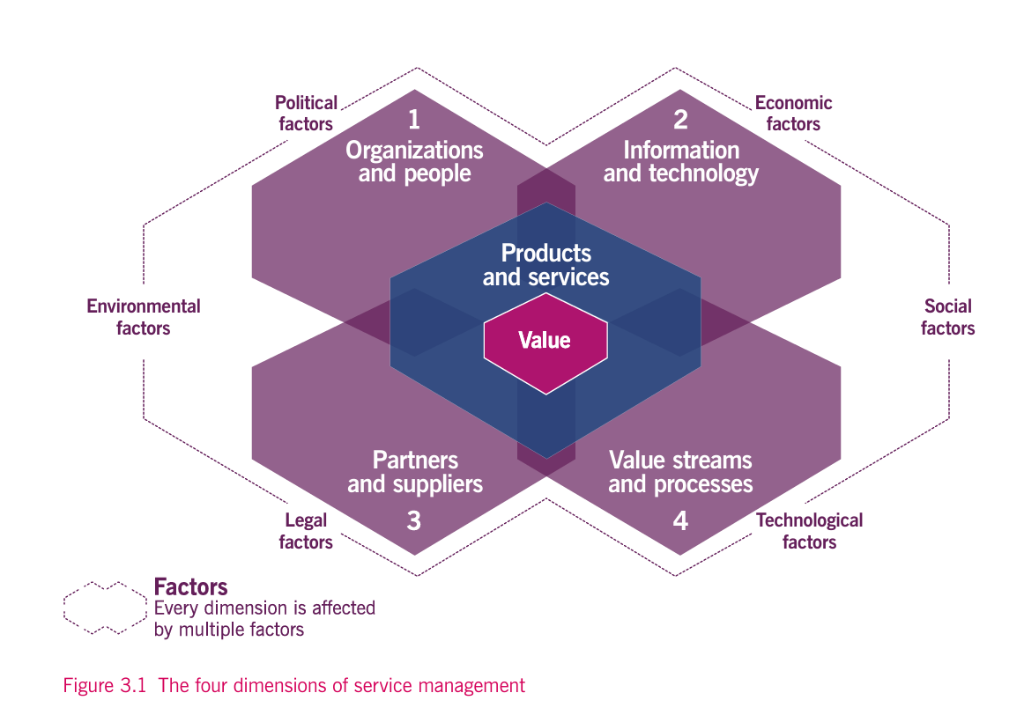

Slide 6
5 Organizations and People
Focus on roles, responsibilities, culture, capacity, and competency.
Employees need skills, collaboration, and awareness of value creation.
Key Message: Organizational structure and culture should support strategy and objectives.
Example: Axle Car Hire’s IT team collaborates with HR, procurement, and facilities.

Slide 7
6 Activity 1
If you were in charge of an IT team, what one cultural value would you introduce to ensure everyone works efficiently and collaborates well?

Slide 8
6 Information and Technology
Includes information, knowledge, and technologies needed to deliver services.
Technology considerations:
Compatibility, automation, emerging tech (AI, IoT, cloud)
Compliance, security, and future viability
Alignment with strategy and staff skills
Example: Axle Car Hire uses booking apps and databases to manage car rentals.

Slide 9
6 Activity 2
Think of a service you use daily (e.g., a food delivery app). What information and technology are critical to make it work smoothly?

Slide 10
6 Partners and Suppliers
Relationships with external organizations for service design, delivery, and improvement.
Range from formal contracts to flexible partnerships.
Strategy depends on core competencies, culture, resource availability, and cost.
Example: Axle partners with Go Go Gas, cleaning services, ISPs, and developers.

Slide 11
6 Activity 3
Name a service you rely on that depends on multiple partners or suppliers. What might happen if one of these partners fails?

Slide 12
6 Value Streams and Processes
Focus on activities, workflows, and procedures to achieve objectives.
Value streams: steps to create and deliver products/services.
Processes: interrelated activities that transform inputs to outputs.
Helps identify waste and improve efficiency.
Example: Axle maps value streams to remove obstacles and enhance productivity.

Slide 13
6 Activity
Take a simple activity you do every day (e.g., ordering coffee). Can you list the steps (value stream) involved and identify one step that could be improved?”

Slide 14
6 External Factors
Organizations operate in dynamic, complex environments.
Factors analyzed via PESTLE: Political, Economic, Social, Technological, Legal, Environmental.
These influence how resources are configured and services delivered.
Example: GDPR influences how companies handle customer data.

Slide 15
6 Activity
Which external factor do you think affects a music streaming service the most? Why?
PESTLE

Slide 16
6 Summary
Four dimensions provide a holistic approach to service management.
Balance of focus across dimensions is essential.
External factors and emerging trends must also be considered.

Slide 17

Thank you…

